Slide 1
Research Agent
CAPSTONE PROJECT
Presented By:
Student Name: TAMIL SELVAN T
College Name: T.J.S Engineering College
Department: B.Tech AI & DS

Slide 2
OUTLINE
Problem Statement
Proposed System/Solution
System Development Approach (Technology Used)
Deployment
Result (Output Image)
Conclusion
Future Scope
References

Slide 3
Problem Statement
The Challenge - A Research Agent is an AI system designed to assist with academic and scientific research tasks. It can autonomously search for literature, summarize papers, and organize references. Using natural language processing, it understands research questions and retrieves relevant information. The agent can generate reports, suggest hypotheses, and even draft sections of research papers. It saves time by automating repetitive tasks like citation management and data extraction. Research Agents enhance efficiency, accuracy, and innovation in both academic and industrial R&D.
Technology - Use of IBM Cloud Lite services /IBM Granite is mandatory.

Slide 4
Proposed Solution
The proposed system aims to Research Agent is an AI system designed to assist with academic and scientific research tasks. It can autonomously search for literature, summarize papers, and organize references. The solution will consist of the following components:
Clear Resources list :
First, clear the resources list for the New project.
Watsonx :
now click on Watsonx.ai and Choose AI agents
Scroll down a little, then click on Agentic Lab and click on Watsonx.ai homepage.
Create a project :
This is next interface, now scroll down this page, create sandbox. Now click on Create a sandbox project.
Enter your project name and scroll down, and Add the Cloud storage for the project.
Added services like watsonx.ai studio and watsonx.ai runtime service.
Then Model Selection and Tools optimization.
Deployment:
Develop a user-friendly interface or application that provides real-time answers for the questions.
Deploy the solution on a scalable and reliable platform, considering factors like server infrastructure, response time, and user accessibility.
GitHub Repo Link: https://github.com/TAMILSELVAN-2108/Research_AI_Agent-

Slide 5
System Approach
The "System Approach" section outlines the overall strategy and methodology for developing and implementing the Research Agent. Here's a suggested structure for this section:
System requirements:
Watsonx.ai studio and runtime services.
Cloud storage service up to 25 GB.
Required to build the model:
Use of IBM Cloud Lite services.
IBM Granite is mandatory.

Slide 6
Model selection & Deployment
In the model section, describe the Granite-3-3-8b instruct model. Here's an example structure for this section:
Model Selection:
Selected the model based on the Research prepose like Granite-3-3-8b instruct and justify its selection based on the problem statement and its characteristics.
Enable tools:
Specify the Tools features like Google search, Wikipedia search, DuckDuckGo search, Webcrawler, Weather.
Training Process:
A Research Agent is an AI system designed to assist with academic and scientific research tasks. It can autonomously search for literature, summarize papers, and organize references. Using natural language processing, it understands research questions and retrieves relevant information..
Prediction Process:
The agent can generate reports, suggest hypotheses, and even draft sections of research papers.
It saves time by automating repetitive tasks like citation management and data extraction.
Research Agents enhance efficiency, accuracy, and innovation in both academic and industrial R&D.

Slide 7
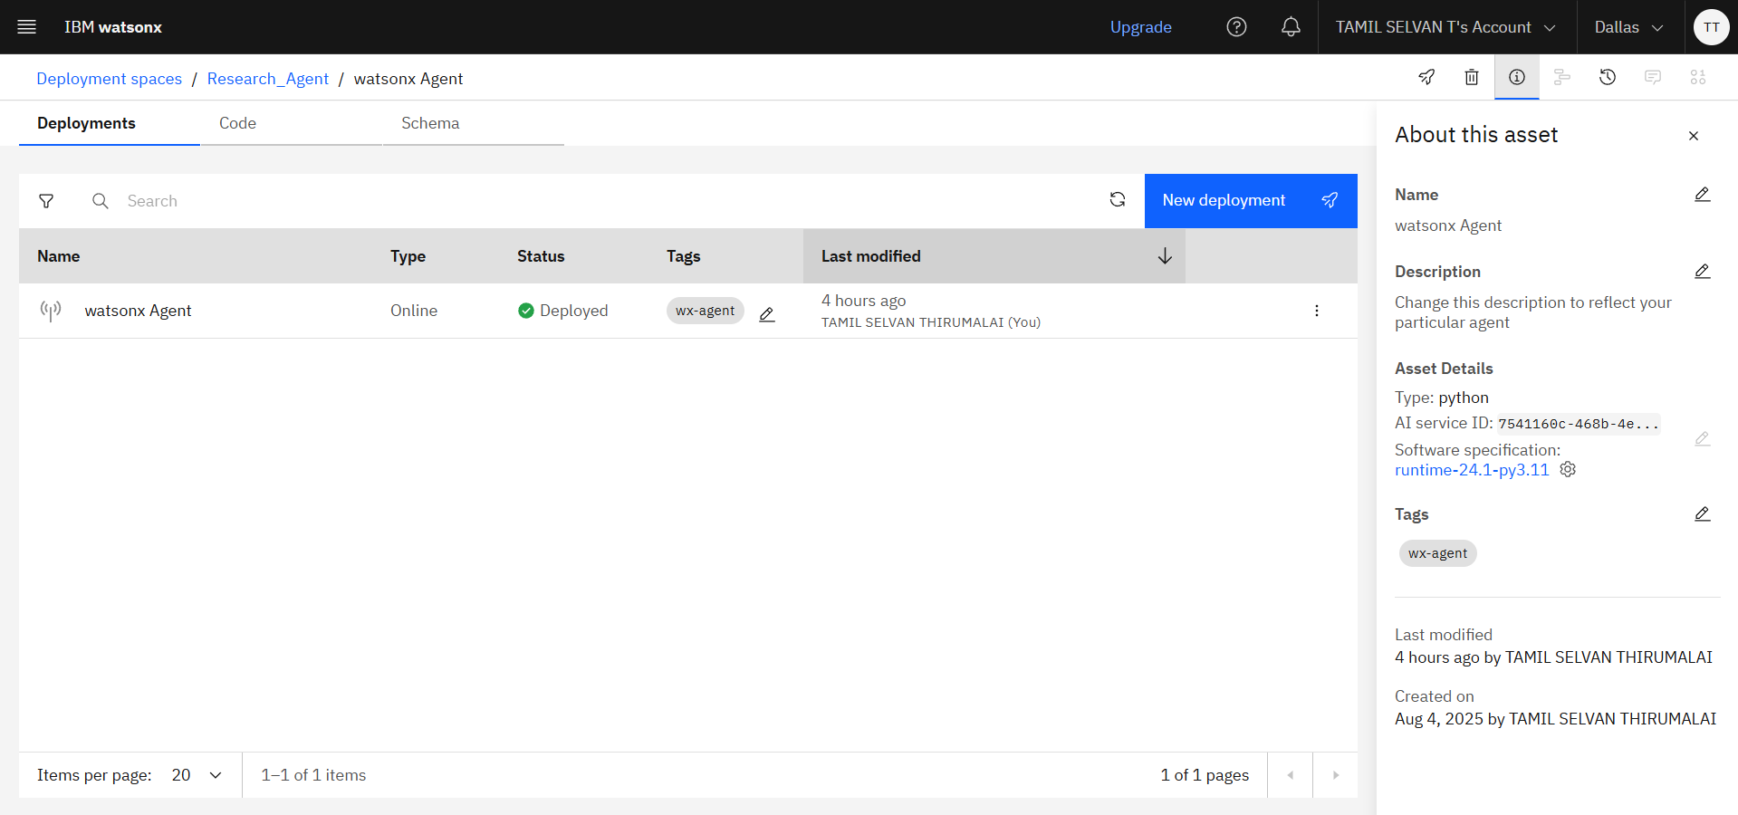
Result:

Slide 8
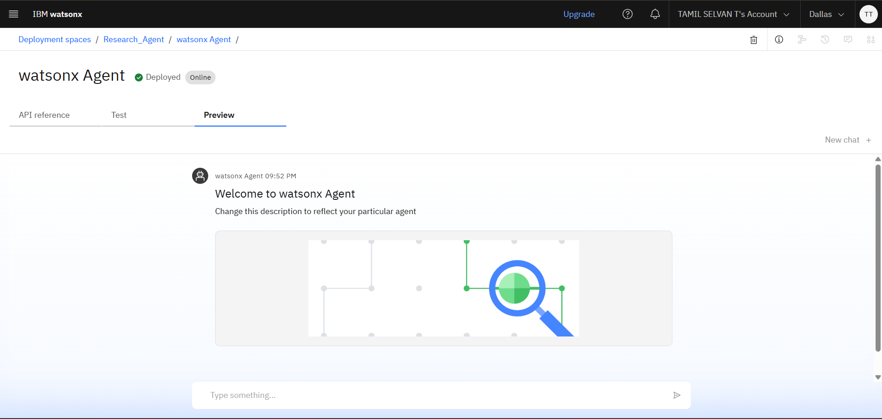
Result: Interface

Slide 9
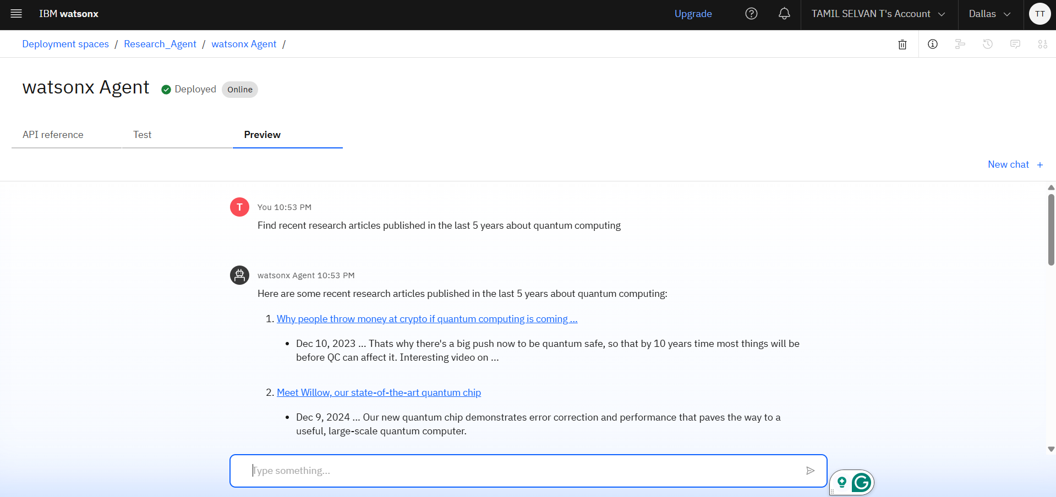
Result: Research agent

Slide 10
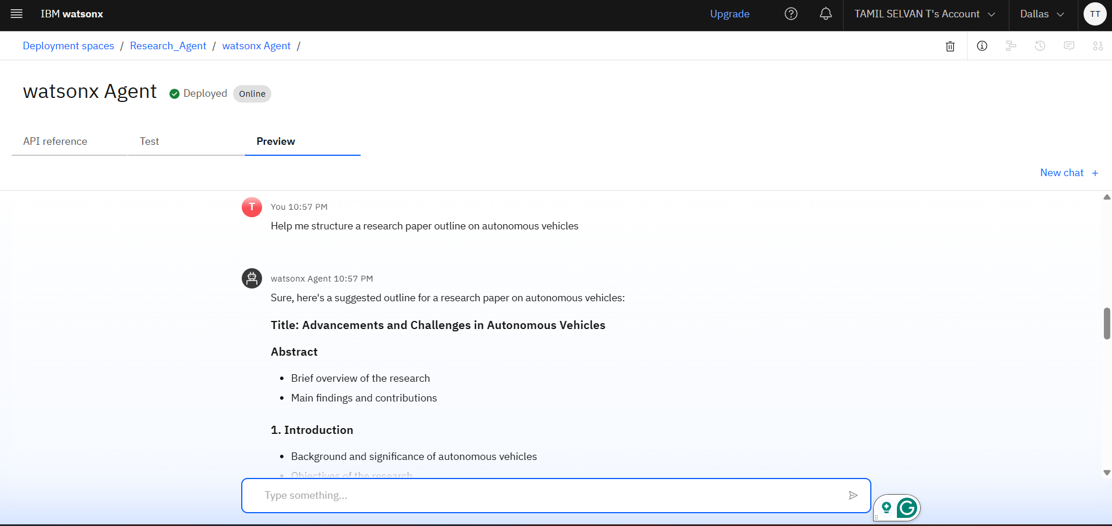
Result: research agent

Slide 11
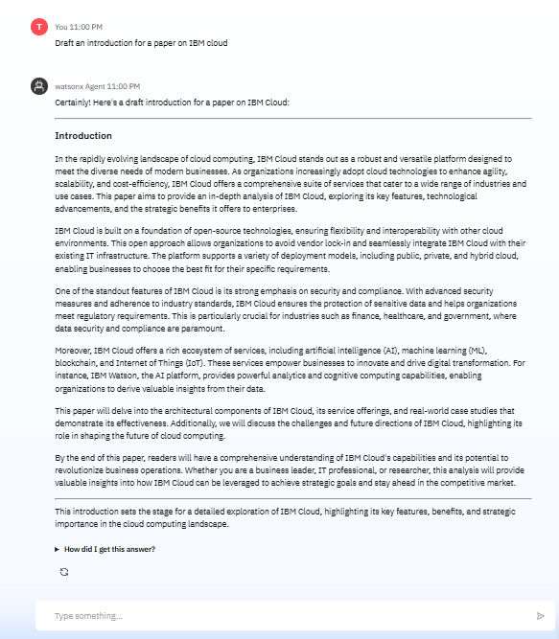
Result: Research agent

Slide 12
Conclusion
The development of a Research Agent represents a transformative step in modernizing the academic and scientific research process. By leveraging artificial intelligence and natural language processing, the system significantly reduces the time and effort required for literature review, information extraction, and manuscript preparation. Its ability to autonomously interpret queries, summarize complex texts, and manage citations allows researchers to focus more on innovation and critical thinking rather than routine tasks. Ultimately, the Research Agent enhances the overall productivity, accuracy, and accessibility of research, making it a valuable tool for both academic institutions and industrial R&D environments.

Slide 13
Future scope
Multilingual and Cross-Domain Support: Expand the agent's capabilities to process research content in multiple languages and across diverse academic disciplines for global accessibility.
Integration with Research Databases: Enable real-time access to platforms like Google Scholar, Scopus, PubMed, and institutional repositories for up-to-date literature retrieval.
Personalized and Context-Aware Assistance: Use machine learning to offer tailored recommendations based on the user’s research history, preferences, and writing style.
Voice and Conversational Interface: Incorporate voice commands and chatbot-style interaction to enhance usability and accessibility for all types of users.
Collaboration and Team Features: Support collaborative workflows by allowing multiple users to share literature libraries, co-edit drafts, and manage citations collectively.
Ethics, Plagiarism, and Journal Compliance: Assist in maintaining research integrity by detecting plagiarism, verifying citations, and ensuring manuscripts align with publication guidelines.

Slide 14
References
Lu Wang et al. (2021) – "Towards Effective Scholarly Paper Summarization: A Survey", ACM Computing Surveys.
Provides an overview of automatic research paper summarization techniques and tools.
DOI: 10.1145/3476003
Sebastian Ruder (2019) – "Neural Transfer Learning for Natural Language Processing", PhD Thesis, National University of Ireland.
Explores how NLP models like BERT and GPT can be fine-tuned for domain-specific research tasks.
OpenAI GPT Models –
Advanced language models capable of summarizing, drafting, and understanding complex academic content.
https://platform.openai.com
Zhang et al. (2020) – "Pegasus: Pre-training with Extracted Gap-sentences for Abstractive Summarization", ICML.
Discusses state-of-the-art approaches to automatic summarization relevant to research assistants.
arXiv:1912.08777

Slide 15
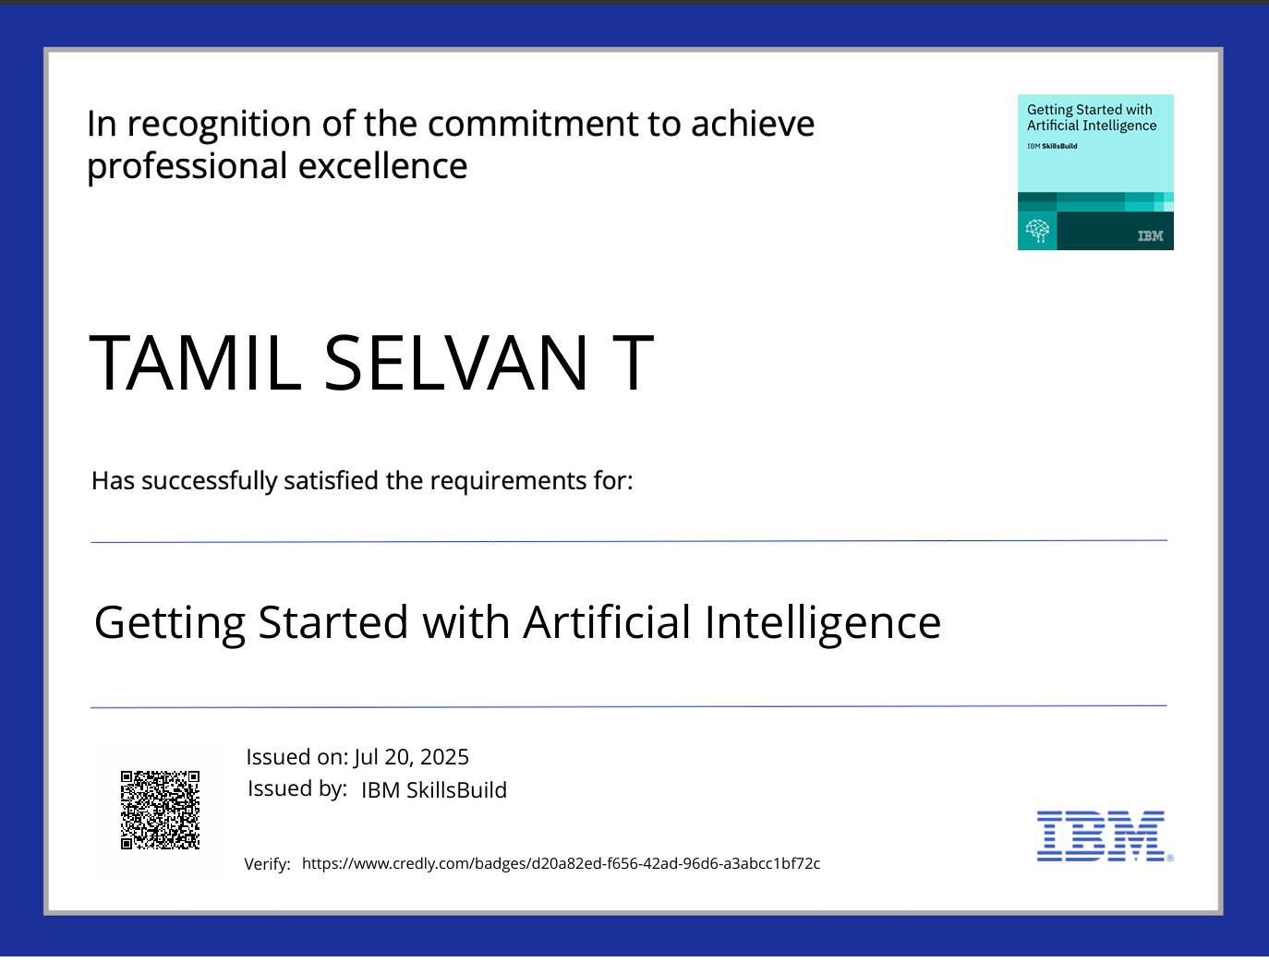
IBM Certifications

Slide 16
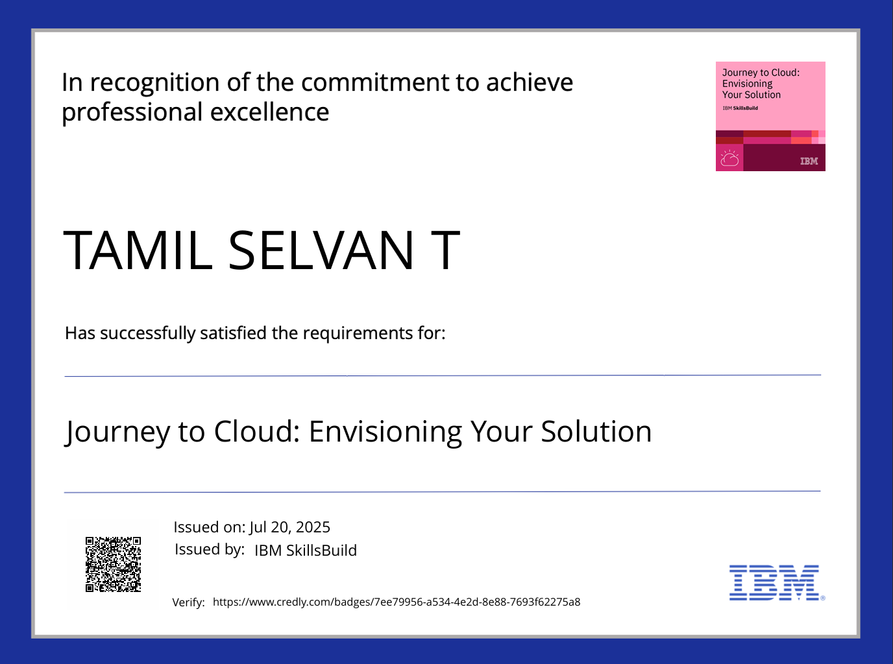
IBM Certifications

Slide 17
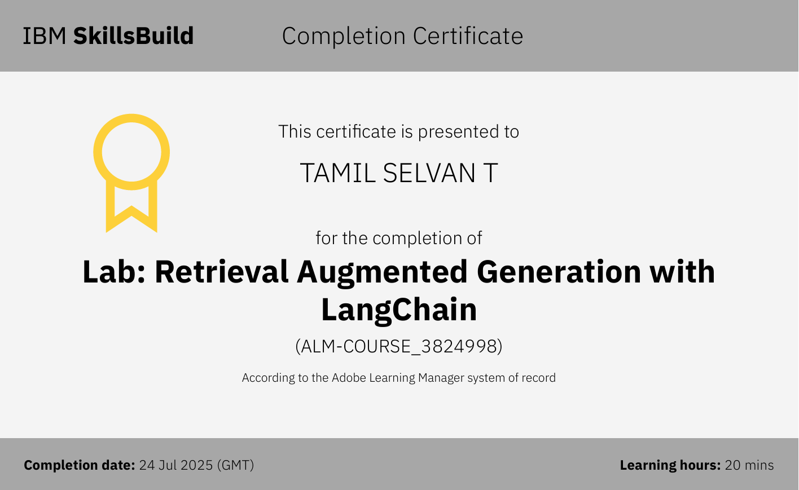
IBM Certifications

Slide 18
THANK YOU

